Slide 1
A-TEAM
Shane, Jerome, Kannan and Siraj

Slide 2
Our Variables
Time Line : 2000 -2010
temperature Fluctuations
Population density
Target Variable: Energy Usage

Slide 3
Our Questions
What correlations can we draw between the changes in temperatures and energy consumption?
Looking at our graphs, which one of the two variables have the most impact on Energy consumption?
Do Temperature and Population variables affect energy consumption more together or independently?

Slide 4
ENERGY USAGE (Kannan)

Slide 5
Statistical Analysis
Null: Energy consumption does not change over the 10 year period
P-value:
Result:

Slide 6
POPULATION density (Jerome)

Slide 7
Statictical Analysis
Null:
P-Value:
Result

Slide 8
Temperature data

Slide 9
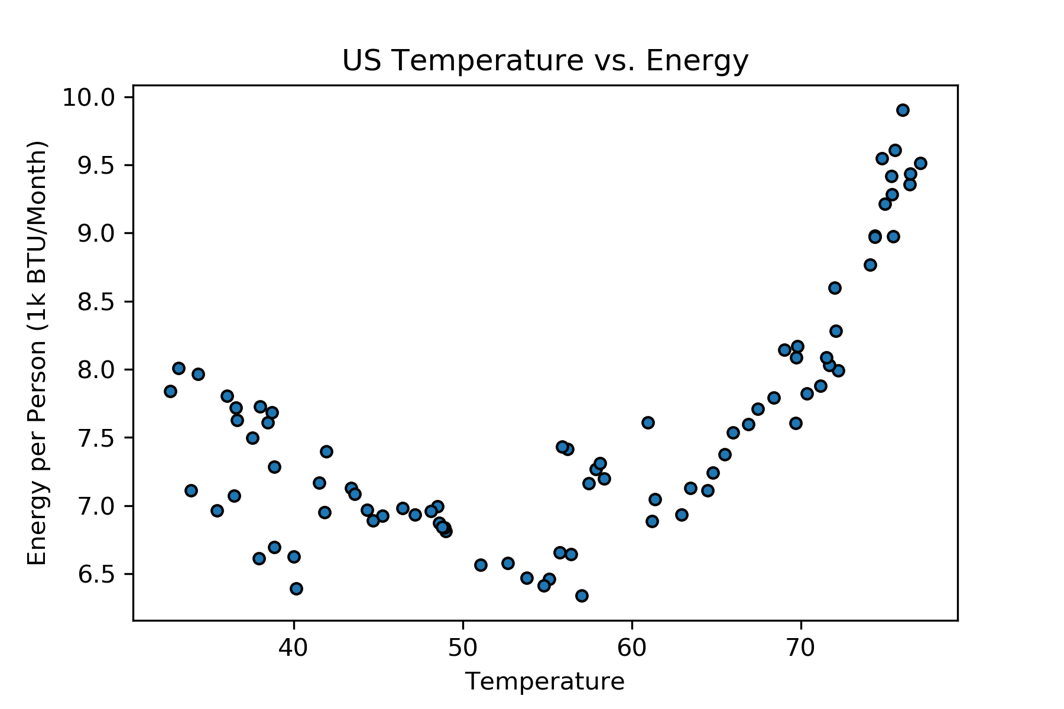
Temperature data

Slide 10
Statistical Analysis
Null Hypothesis:
P-Value:
Result:

